Slide 1
14TH Annual SAA 2020 Research Forum
#SAA20RF @SAAResearch
August 5, 2020
On Zoom

Slide 2
#SAA20RF @SAAResearch
Virtual Research Forum Team
Nance McGovern – forum host, session facilitator, hopeful realist
Kari Smith – session facilitator and Zoom wrangler
Heather Soyka – social media, Q&A fiddling, dot connector
Kate Neptune – Q&A coordination, notes, timekeeping, miracles
Rebecca C. Thayer – Q&A coordination, notes, timekeeping, team spirit
SAA Staff
All of our Research Forum Presenters
All of our attendees and viewers
Thank you, all!

Slide 3
#SAA20RF @SAAResearch
2020 RF Reports and Papers
All poster and platform presenters are invited to submit a:
research report: information in any form that supplements the presentation
research paper: well-formed research papers that do not go through peer review – out of scope or author preference
peer-reviewed research paper: well-formed papers that goes through our peer review process
Due: November 1
Submission information to follow …

Slide 4
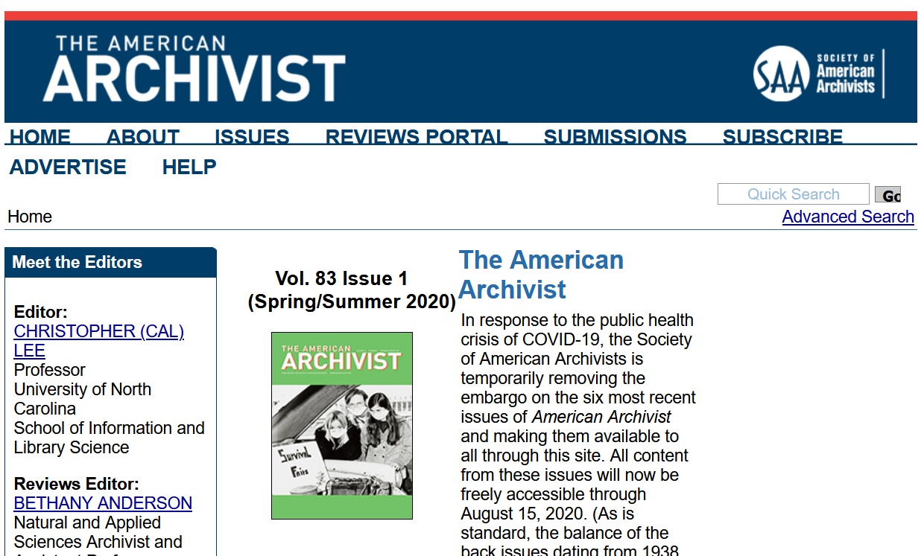
Register as a reviewer (through PeerTrack)
Contact Editor or other Editorial Board members with questions, comments or ideas for articles or book reviews
Read guidance for authors
Submit an article
https://americanarchivist.org/

Slide 5
See you next year! watch for some special 15th anniversary surprises …
#SAA20RF @SAAResearch

